Slide 1
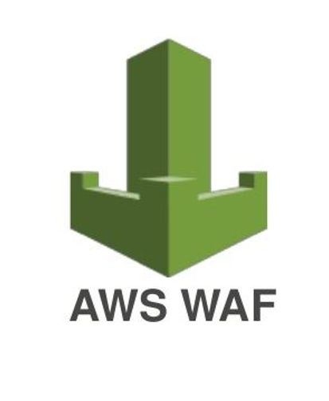
Topic on:-
Presented By:-
Sai varun Reddy
Batch - 15

Slide 2
What is AWS WAF?
A Web Application Firewall from AWS.
It sits in front of your web application (like an API Gateway, CloudFront, or Application Load Balancer).
It monitors all incoming HTTP(S) requests.
Goal: Protects your application from common web exploits (e.g., hackers and malicious bots) that could affect availability, compromise security, or consume excessive resources.

Slide 3
The Core Concept: How WAF Works:-
WAF is all about Rules: You define rules that inspect incoming traffic for suspicious patterns.
Analogy: Think of WAF as a bouncer at a club 👮:
It checks the ID (the request's attributes like IP address, country, or headers).
It checks for forbidden items (malicious code like SQL injection or Cross-Site Scripting).
The Three Actions: For every request, WAF can take one of three actions:
ALLOW: Let the request pass through to the application.
BLOCK: Stop the request and send back an error (usually HTTP 403 Forbidden).
COUNT: Log the request as a match for a rule, but still allow it to pass (useful for testing new rules).

Slide 4
Key Components (The Building Blocks)
1. Web ACL (Access Control List):
The main container for your security strategy.
It holds all your Rules and Rule Groups.
You attach a Web ACL to the AWS resource you want to protect (e.g., your ALB).
It defines a Default Action (e.g., "Block everything unless a rule allows it").
2. Rules:
The specific conditions WAF looks for.
Example: "If the request comes from IP address 1.2.3.4, then BLOCK it."
Example: "If the request contains the suspicious phrase ' UNION SELECT ', then BLOCK it (to prevent SQL Injection)."
3. Rule Groups:
A reusable collection of rules.
AWS Managed Rule Groups: Pre-built, maintained, and updated by AWS for common threats (like the OWASP Top 10 or Bot Control). This is the easiest way to start!

Slide 5
Advantages
Stops Common Web Attacks: Effectively blocks high-risk threats like SQL Injection and Cross-Site Scripting (XSS).
Protects Critical Data: Prevents attackers from stealing sensitive information from your web applications.
Acts as a Virtual Patch: Can immediately block attacks against a vulnerability before a code fix is deployed.
Mitigates DDoS Attacks: Limits traffic surges to prevent application-layer Denial of Service (DDoS) events.
Improves Visibility: Provides logs and monitoring to help you see and understand attack attempts in real-time.
Disadvantages
Risk of False Positives: Can accidentally block legitimate users if security rules are set too strictly.
Vulnerable to Zero-Days: May not be able to stop new, unknown attacks until its threat signatures are updated.
Can Add Latency: The inspection process can sometimes slightly slow down web application performance.
Requires Ongoing Tuning: Needs constant maintenance and rule adjustments as your application changes.
Limited Scope: Only protects the application layer and does not secure the underlying network or server.

Slide 6


Slide 7


